Slide 1
Taiwan Credit Default
Dataset – “Default of credit card”
Team Members: Anthony Champion, Rafael Hernandez, and Rajinder Singh

Slide 2
Business Contest and Problem Statement
A Taiwan-based credit card issuer wants to better predict the likelihood of default for its customers, as well as identify the key drivers that determine this likelihood. This would inform the issuer’s decisions on who to give a credit card to and what credit limit to provide. It would also help the issuer have a better understanding of their current and potential customers, which would inform their future strategy, including their planning of offering targeted credit products to their customers.

Slide 3
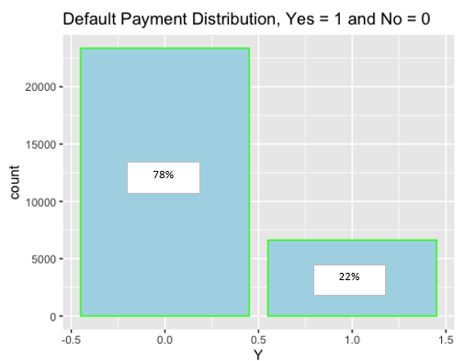
Dataset and Cleansing
Dataset: Observations – 30,000, Variables - 25
tibble [30,000 × 25] (S3: tbl_df/tbl/data.frame) $ ID : num [1:30000] 1 2 3 4 5 6 7 8 9 10 ... $ LIMIT_BAL: num [1:30000] 20000 120000 90000 50000 … $ SEX : num [1:30000] 2 2 2 2 1 1 1 2 2 1 ... $ EDUCATION: num [1:30000] 2 2 2 2 2 1 1 2 3 3 ... $ MARRIAGE : num [1:30000] 1 2 2 1 1 2 2 2 1 2 ... $ AGE : num [1:30000] 24 26 34 37 57 37 29 23 28 35 ... $ PAY_0 : num [1:30000] 2 -1 0 0 -1 0 0 0 0 -2 ... $ PAY_2 : num [1:30000] 2 2 0 0 0 0 0 -1 0 -2 ... $ PAY_3 : num [1:30000] -1 0 0 0 -1 0 0 -1 2 -2 ... $ PAY_4 : num [1:30000] -1 0 0 0 0 0 0 0 0 -2 ... $ PAY_5 : num [1:30000] -2 0 0 0 0 0 0 0 0 -1 ... $ PAY_6 : num [1:30000] -2 2 0 0 0 0 0 -1 0 -1 ... $ BILL_AMT1: num [1:30000] 3913 2682 29239 46990 8617 ... $ BILL_AMT2: num [1:30000] 3102 1725 14027 48233 5670 ... $ BILL_AMT3: num [1:30000] 689 2682 13559 49291 35835 ... $ BILL_AMT4: num [1:30000] 0 3272 14331 28314 20940 ... $ BILL_AMT5: num [1:30000] 0 3455 14948 28959 19146 ... $ BILL_AMT6: num [1:30000] 0 3261 15549 29547 19131 ... $ PAY_AMT1 : num [1:30000] 0 0 1518 2000 2000 ... $ PAY_AMT2 : num [1:30000] 689 1000 1500 2019 36681 ... $ PAY_AMT3 : num [1:30000] 0 1000 1000 1200 10000 657 38000 ... $ PAY_AMT4 : num [1:30000] 0 1000 1000 1100 9000 ... $ PAY_AMT5 : num [1:30000] 0 0 1000 1069 689 ... $ PAY_AMT6 : num [1:30000] 0 2000 5000 1000 679 ... $ Y : num [1:30000] 1 1 0 0 0 0 0 0 0 0 ...
Limit_BAL: Range – $10K to $1M (Mean - $167K)
Sex: Female – 60%, Male – 40%
Education: Graduate School (35%), University (47%), High School (16%), Others
Marriage: Married(46%), Single (53%), Others
Age: Range – 21 yrs to 79 yrs (Mean – 35 yrs)
PAY: History of past payment (past 6 months)
Bill_AMT: Amount of bill statement (past 6 months)
PAY_AMT: Amount of pervious payment (past 6 months
Y: Default payment, Yes = 1 (22%), No = 0 (78%)
Question:
Which model is able to achieve the best performance?
Models:
Decision Tree, SVM, KNN, Naïve Bayes
Notes:
The credit card issuer has gathered information on 30000 customers. The dataset contains information on 25 variables, including demographic factors, credit data, history of payment, and bill statements of credit card customers from April 2005 to September 2005, as well as information on the outcome: did the customer default or not
This dataset contains 30000 observations of 25 variables from a bank (and also a cash and credit card issuer in Taiwan); where each observation corresponds to a particular credit card client. Among the total 30000 observations, 6636 observations (22.1%) are cardholders with default payment.
we cannot use accuracy to measure our model’s effectiveness)

Slide 4
Exploring the Data

Slide 5
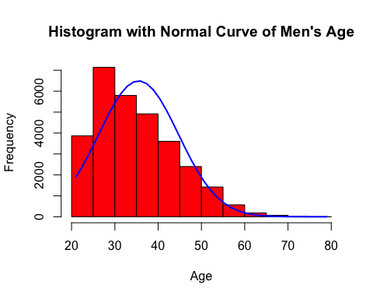
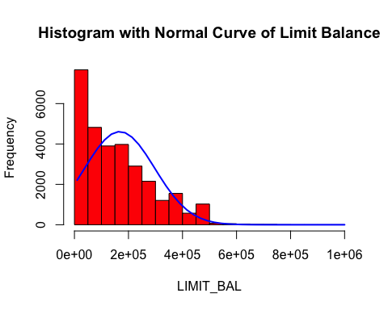
Histogram – Age and Limit Balance
Average : 35.5
Median : 34.0
Std Dev: : 9.2
Average : 167,484
Median : 140,000
Std Dev: : 129,747
Notes:
Normal distribution – mean & median in the center, with zero skew, few outliers
Standard Normal distribution – mean = 0 & variance = 1

Slide 6
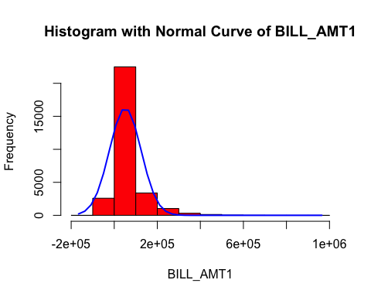
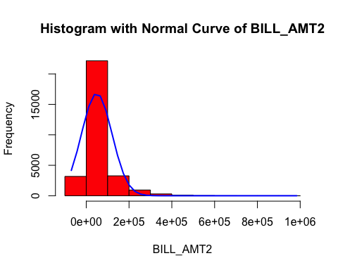
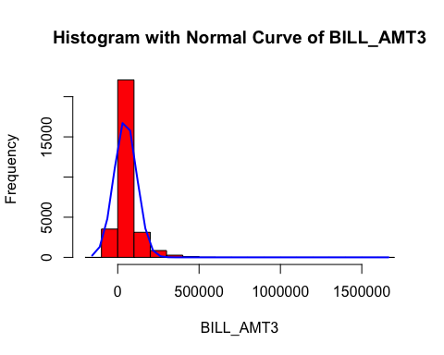
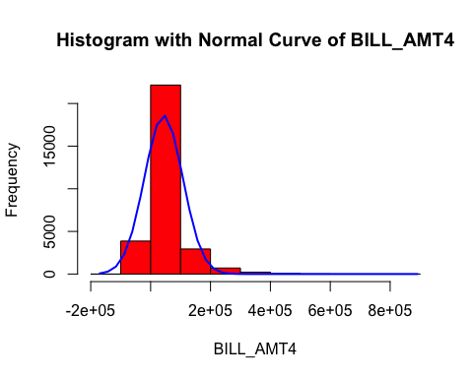
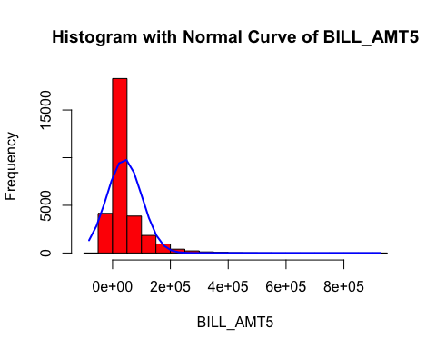
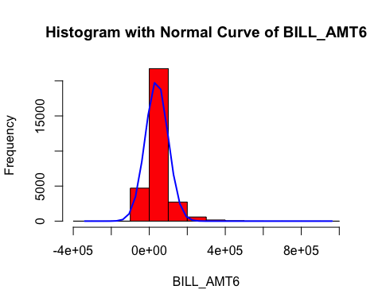
Histogram – Bill Amount past 6 months
Average : 51,223
Median : 22,382
Std Dev: : 73,635
Average : 49,179
Median : 21,200
Std Dev: : 71,173
Average : 47,013
Median : 20,008
Std Dev: : 69,349
Average : 43,263
Median : 19,052
Std Dev: : 64,333
Average : 40,311
Median : 18,105
Std Dev: : 60,797
Average : 38,872
Median : 17,071
Std Dev: : 59,554

Slide 7
Modeling

Slide 8
Decision Tree Model
Preprocessing:
Check for missing values
Remove variable “ID”
Model Training:
Split dataset (70% - train set & 30% - test set)
Convert variable “Y” to Nominal
Base Model:
dt_model <- train(Y ~., data = train.data, metric = "Accuracy", method = "rpart")
Pre-Pruning Model:
dt_model_preprune <- train(Y ~., data = train.data, method = "rpart", metric = "Accuracy", tuneLength = 8, control = rpart.control(minsplit = 150, minbucket = 60, maxdepth = 4))
Post-Pruning Model:
dt_model_postprune <- prune(dt_model$finalModel, cp = 0.01) print(dt_model_postprune

Slide 9
Decision Tree Model – Performance and Evaluation
Model Type | Base | Pre-Pruning Tunelength =8, Minsplit = 150, Minbucket = 60 Maxdepth = 4 | Post-Pruning
Train Data | 70% of the full data set | 70% of the full data set | Base Model
Complexity Parameter (CP) | 0.002137209 | 0.001282325 | 0.01
Accuracy | 82.06% | 81.98% | NA
Predict Data | 30% of the full data set | 30% of the full data set | 30% of the full data set
Accuracy | 82.08% | 82.11% | 82.01%
Sensitivity (non-defaulters) | 94.87% | 95.07% | 95.87%
Specificity (defaulters) | 36.02% | 35.46% | 32.14%
Precision | 84.21% | 84.13% | 83.56%
Recall | 94.87% | 95.07% | 95.87%
F Measure | 89.23% | 89.27% | 89.29%
Area Under the Curve | 0.69 | 0.6912 | NA
Notes:
Predict the defaultwes…defaulters are what we are searching for

Slide 10
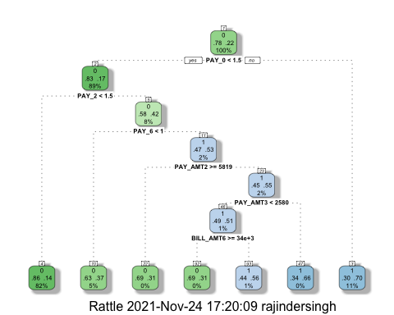
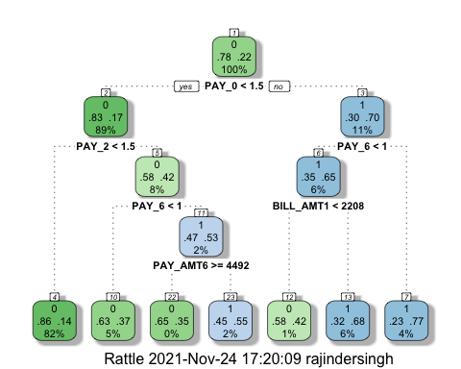
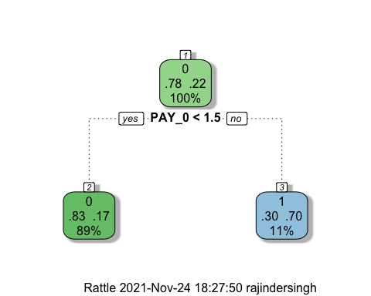
Decision Tree Model - Plot
Base
Preprune
Postprune
Notes:
If no…70% defaulted…30 nondefluat

Slide 11
Support Vector Machine (SVM) Model
Preprocessing:
Check for missing values
Remove variable “ID”
Model Training:
Split dataset (70% - train set & 30% - test set)
Convert variable “Y” to Nominal
Base Model - Linear:
svm(Y ~., data = train.data, type = ‘C’, kernel = ‘linear’, cross = 3, probability = TRUE)
Best Parameter:
Cost – 0.1, Error – 0.1964301
Cost – 1, Error – 0.1964295
Cost – 10, Error – 0.1964411
Tuning - Linear:
tune.svm(Y ~., data = train.data, cost = 10^(-1:1, kernel = “linear”)
Tune Model - Linear:
svm(Y ~., data = train.data, type = ‘C’, kernel = ‘linear, cross = 3, cost = 1, probability = TRUE)
Best Parameter:
Gamma – 0.1, Cost - 0.1, Error – 0.1562187
Gamma – 1, Cost - 0.1, Error – 0.1943659
Gamma – 10, Cost - 0.1, Error – 0.2014518
Gamma – 100, Cost - 0.1, Error – 0.2017929
Gamma – 0.1, Cost - 1, Error – 0.1560085
Gamma – 1, Cost - 1, Error – 0.1650327
Gamma – 10, Cost - 1, Error – 0.1764909
Gamma – 100, Cost - 1, Error – 0.1771383
Gamma – 0.1, Cost - 10, Error – 0.1654672
Gamma – 1, Cost - 10, Error – 0.1840100
Gamma – 10, Cost - 10, Error – 0.1815661
Gamma – 100, Cost - 10, Error – 0.1744584
Base Model - Radial:
svm(Y ~., data = train.data, type = ‘C’, kernel = ‘radial’, cross = 3, probability = TRUE)
Tuning - Radial:
tune.svm(Y ~., data = train.data, gamma = 10^(-1:2), cost = 10^(-1:1)
Tune Model - Radial:
svm(Y ~., data = train.data, type = ‘C’, kernel = ‘linear, cross = 3, probability = TRUE, gamma = 0.1, cost = 1)
Notes:
1.St is Linear Kerrenl….then tunded….ran another model on radial Kerneal…

Slide 12
SVM Model – Performance and Evaluation
Model Type | Base – Linear Cross Validation = 3 | Best Tuning Parameters - Linear | Base – Radial Cross Validation = 3 | Best Tuning Parameters – Radial Cross Validation = 3
Train Data | 70% of the full data set | 70% of the full data set | 70% of the full data set | 70% of the full data set
Cost | 1 | 1 | 1 | 1
Gamma | N/A | N/A | 1 | 0.1
Accuracy | 81.08% | 80.91% | 81.91& | 81.89%
Predict Data | 30% of the full data set | 30% of the full data set | 30% of the full data set | 30% of the full data set
Accuracy | 81.02% | 81.02% | 82.17% | 82.03%
Sensitivity (non-defaulters) | 82.06% | 82.06% | 83.84% | 83.74%
Specificity (defaulters) | 68.34% | 68.34% | 68.26% | 67.71%
Precision | 96.95% | 96.95% | 95.66% | 95.59%
Recall | 82.06% | 82.06% | 83.84% | 83.74%
F Measure | 88.88% | 88.88% | 89.36% | 89.28%
Area Under the Curve | 0.6033 | 0.6033 | 0.6464 | 0.6441

Slide 13
K Nearest Neighbor (kNN) Model
K Accuracy
70 0.8049998
80 0.8056665
90 0.8055236
100 0.8055236
110 0.8051903
120 0.8053332
130 0.8051903
Preprocessing:
Check for missing values
Remove variable - ID
Normalized all variables except “Y”
Preprocessing:
Check for missing values
Remove variable - ID, SEX, EDUCATION, MARRIAGE, BILL_AMT
Normalized all variables except “Y”
K Accuracy
50 0.8163810
60 0.8170000
70 0.8174762
80 0.8163810
90 0.8157619
100 0.8158095
110 0.8158571
Model Training:
Split dataset (70% - train set & 30% - test set)
Convert variable “Y” to Nominal
Model Training:
Split dataset (70% - train set & 30% - test set)
Convert variable “Y” to Nominal
Tuning Model:
Grid = expand.grid(k = c(70, 80, 90, 100, 110, 120, 130)
train(Y ~., method = “knn”, data = combine.train.data.n, trControl = trainControl (method = ‘cv’, number = 3, search = ‘grid’), tuneGrid = grid)
Tuning Model:
Grid = expand.grid(k = c(50, 60, 70, 80, 90, 100, 110)
train(Y ~., method = “knn”, data = combine.train.data.n, trControl = trainControl (method = ‘cv’, number = 3, search = ‘grid’), tuneGrid = grid)
Variable Importance
PAY_0 100
PAY_2 73.67
PAY_3 65.62
LIMIT_BAL 63.06
PAY_4 58.27
PAY_AMT1 57.68
PAY_5 52.49
Variable Importance
PAY_0 100
PAY_2 55.05
PAY_3 41.29
LIMIT_BAL 36.93
PAY_4 28.74
PAY_AMT1 27.73
PAY_5 18.25
Base Model:
knn(train = train.data.n, test = test.data.n, cl = train_lable, k = knn$bestTune, prob = TRUE)
Base Model:
knn(train = train.data.n, test = test.data.n, cl = train_lable, k = knn$bestTune, prob = TRUE)
Notes:
Find the important variables

Slide 14
KNN Model - Performance and Evaluation
Model Type | Base | Tuned Excluded variables – Sex, Education , Marriage, Age & Bill_Amt
Train Data | 70% of the full data set (normalized) | 70% of the full data set (normalized)
K - best tuned | 80 | 70
Accuracy | 80.57% | 81.75%
Predict Data | 30% of the full data set (normalized) | 30% of the full data set (normalized
Accuracy | 81.01% | 81.76%
Sensitivity (non-defaulters) | 95.87% | 94.42%
Specificity (defaulters) | 27.54% | 36.18%
Precision | 82.64% | 84.19%
Recall | 95.87% | 94.42%
F Measure | 88.77% | 89.01%
Area Under the Curve | 0.7414 | 0.7242

Slide 15
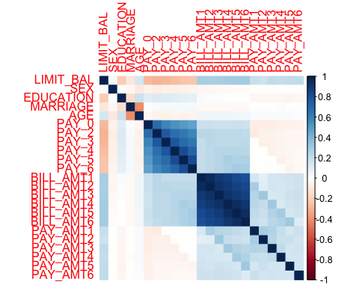
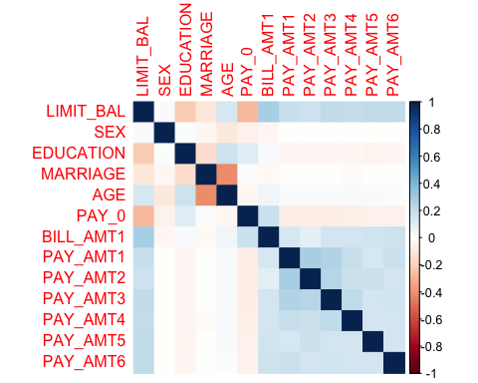
Naïve Bayes Model
Preprocessing:
Check for missing values
Remove variable - ID
Normalized all variables except “Y”
Preprocessing:
Check for missing values
Remove variable – PAY_2 to PAY_6, BILL_AMT2 to BILL_AMT6
Normalized all variables except “Y”
Model Training:
Split dataset (70% - train set & 30% - test set)
Convert variable “Y” to Nominal
Model Training:
Split dataset (70% - train set & 30% - test set)
Convert variable “Y” to Nominal
Base Model:
naiveBayes(as.factor(Y)~., data = train.data)
Tune Model:
naiveBayes(as.factor(Y)~., data = train.data)
Correlation Matrix
Notes:
Payemnts corralted…2nd chart is the least correlated…less dark blue…

Slide 16
Naïve Bayes Model - Performance and Evaluation
Model Type | Base | Tuned Excluded variables – PAY_2 to PAY_6, BILL_AMT2 to BILL_AMT6
Train Data | 70% of the full data set (normalized) | 70% of the full data set (normalized)
Accuracy | 74.97% | 41.96%
Predict Data | 30% of the full data set (normalized) | 30% of the full data set (normalized
Accuracy | 75.08% | 40.61%
Sensitivity (non-defaulters) | 79.3% | 27.81%
Specificity (defaulters) | 59.89% | 86.66%
Precision | 87.67% | 88.24%
Recall | 79.3% | 27.81%
F Measure | 83.28% | 42.29%
Area Under the Curve | 0.6959 | 0.5724

Slide 17
Summary
Model Type | Decision Tree Base CP = 0.002137209 | SVM Base – Linear Cross Validation = 3 Cost = 1 | KNN Tuned Excluded variables – Sex, Education , Marriage, Age & Bill_Amt K = 70 | Naïve Bayes Tuned Excluded variables – PAY_2 to PAY_6, BILL_AMT2 to BILL_AMT6
Train Data | 70% of the full data set | 70% of the full data set | 70% of the full data set (normalized) | 70% of the full data set (normalized)
Accuracy | 82.06% | 81.08% | 81.75% | 41.96%
Predict Data | 30% of the full data set | 30% of the full data set | 30% of the full data set (normalized) | 30% of the full data set (normalized)
Accuracy | 82.08% | 81.02% | 81.76% | 40.61%
Sensitivity (non-defaulters) | 94.87% | 82.06% | 94.42% | 27.81%
Specificity (defaulters) | 36.02% | 68.34% | 36.18% | 86.66%
Precision | 84.21% | 96.95% | 84.19% | 88.24%
Recall | 94.87% | 82.06% | 94.42% | 27.81%
F Measure | 89.23% | 88.88% | 89.01% | 42.29%
Area Under the Curve | 0.69 | 0.6033 | 0.7242 | 0.5724
Notes:
Highlight Decision Tree – if you want both groups at a high accuracy in the same model

